Slide 1
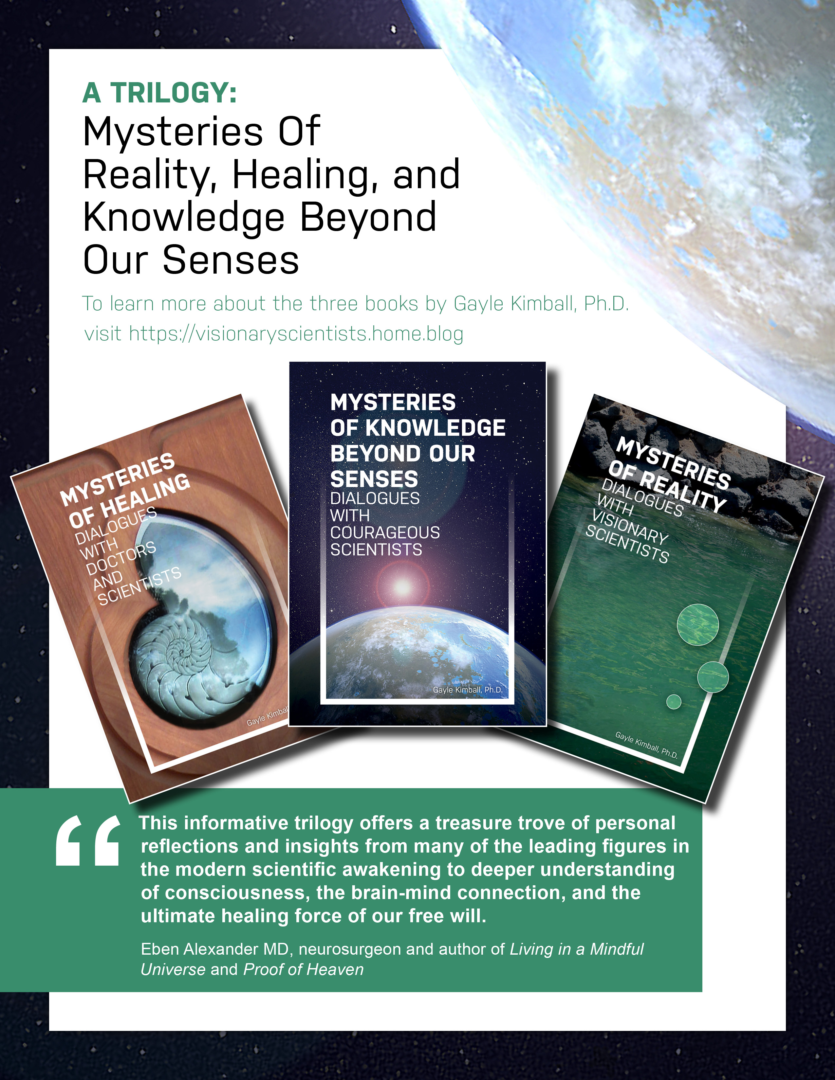
Visionary Scientists
www.gaylekimball.info

Slide 2
Larry Dossey
Larry Dossey, MD: I just finished reading your Mysteries of Healing: Dialogues with Doctors and Scientists. I have known most of the contributors for many years, but I knew almost nothing about their backgrounds and private thoughts about the issues you raised. The book is a profound contribution to our understanding of consciousness, healing, and basic common sense in living in today's complex world.
Dr. Dossey pointed out; “It takes a rabble-rouser to actually develop the courage” to take on the establishment.

Slide 3
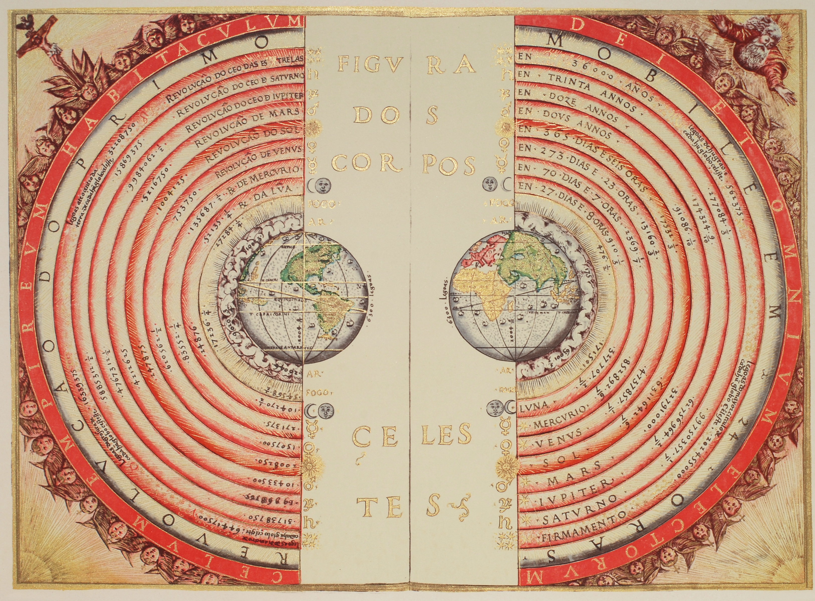
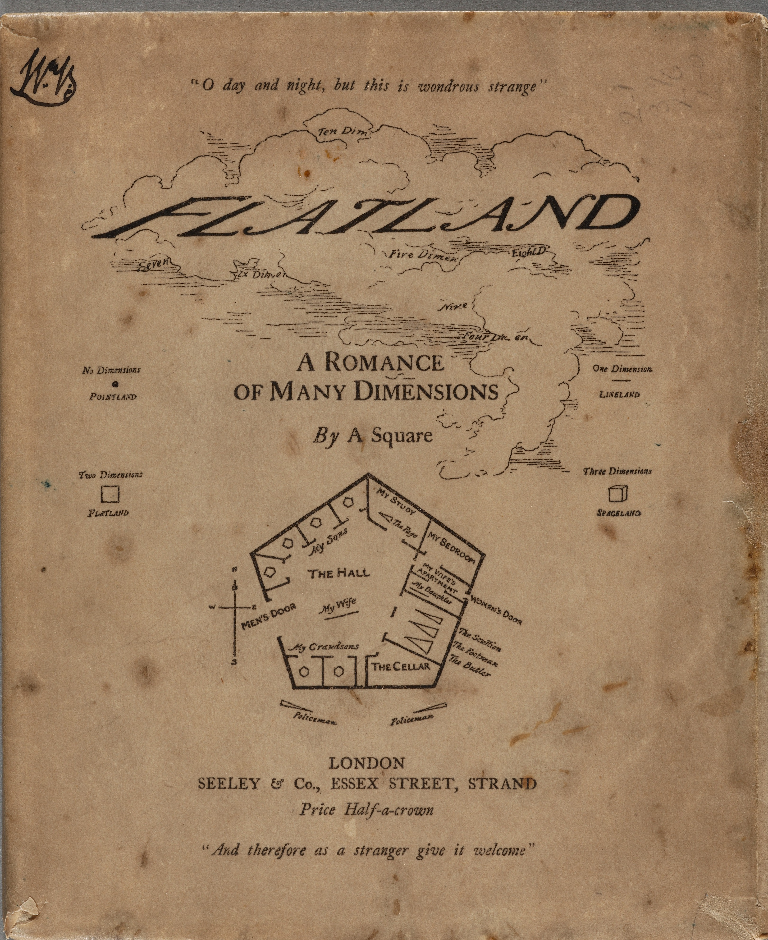
The 2D Materialist Worldview

Slide 4

Research Issues
Etzel Cardeña article on psi evidence (American Psychologist, 2018)
Pigs can’t fly so why study flying pigs? Arthur Reber and James Alcock
Chris Roe: Now study the how/process, not the proof for psi,
vs. science by consensus (Brian Josephson)
Consilience and meta-analysis are key
Everything you think is true is wrong. Bill Bengston
Consequence: Bernardo Kastrup views materialist dogma as making us collectively mad, enmeshed in a collective trance that leads to immorality.

Slide 5

Consciousness Paradigm
Dean Radin suggests, “What is needed for a new paradigm is a more comprehensive model of reality where consciousness becomes just as fundamental, if not more so, than materialism.”
Ancient Greek philosophers, such as Anaxagoras in 480 BCE, emphasized the primacy of mind and consciousness although his contemporary, Plato’s idea of ideal forms is better known. Ancient Hinduism, Buddhism, and Jainism also recognized that the material world is maya, illusion, and through meditation, sages develop psi abilities called siddhis, such as clairvoyance or bilocation.

Slide 6
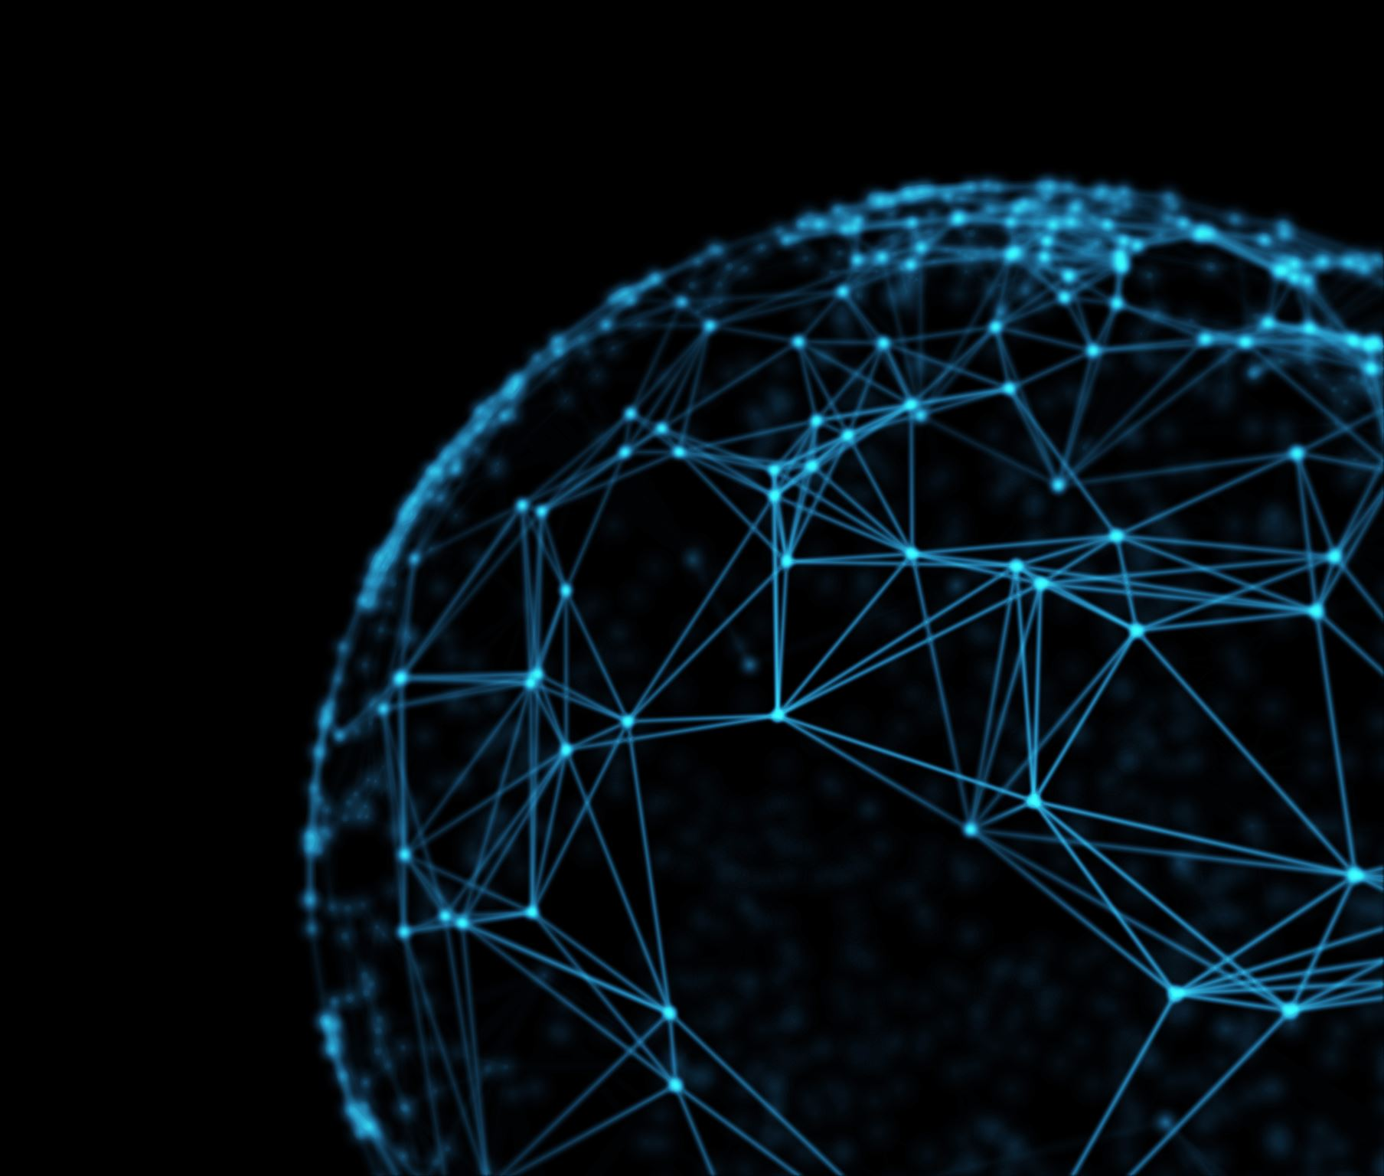
Difficult to Define the Consciousness Paradigm
One Mind, spirit, energy, The Force, matrix, hologram, meaning fields, biofield, cosmic intelligence, information, panpsychism, non-local beyond space and time, substrate, non-physical web, spiritual computer, and fifth dimension. Its basic language is mathematics and patterns like fractals.

Slide 7
Take Aways
Quantum mechanics is closest to reality. Both QM and psi involve consciousness from an unknown source that can’t be shielded, beyond space and time. Intention impacts matter.
Our brains are just filters and transducers. Mind/consciousness continues in NDEs and after death.
Materialism greatly limits our abilities: “We are more than we think we are.” Menas Kafatos

Slide 8
Who are the Brave Visionary Scientists?
Curious musicians
First-born in their families (35 compared to 26 latter-born)
First generation from India, Latvia, Palestine, Ireland, Brazil
Their most common signs are Sagittarius (10) and Aquarius and Libra (both 8).

Slide 9
Need Young Researchers
The 65 scientists are Ph.D.s, M.D.s, and psychologists from the US, Canada, UK, Germany, Italy, and the Netherlands. Most psi researchers are older white men, as is true for the trilogy authors. At 48 John Kruth was considered a youngster when he started doing research at the Rhine Center.
Only two are people of color and only 18 women. The women have fewer than the 1.9 average children per woman in the US and UK, with 16 children between them.
(Univ. of Washington Bothell 2014, 1st Consciousness Study Minor)

Slide 10

Personal or Family Experiences
Jeffrey Mishlove interviewed over a thousand visionary scientists for his video show “New Thinking Allowed.” He reported, “I've discovered that quite a number of prominent people in parapsychology have a Jewish background. Jews are a tiny minority but Jewish people are prominent in every cutting-edge activity in which I've ever been involved.”
“I would say 95% of the people who explore these areas scientifically do so because, like me, they've had powerful personal experiences.”

Slide 11

Intuitive
intuitive types rather than sensing personality types on the Myers–Briggs Type Indicator and Keirsey and Bates. Only two (men) scored sensing rather than intuitive. They’re more extroverted than the typical research scientist: Our group profile is Extrovert, Intuitive, Feeling, and very close but slightly more Judging, called “Idealist Teachers or Champions.”
“Most working scientists probably tend to be way more thinking than feeling, so you have collected a group of odd ducks,” observed psychologist Jim Carpenter.
ENFJs are idealist organizers, driven to implement their vision of what is best for humanity. They often act as catalysts for human growth because of their ability to see potential in other people and their charisma in persuading others to their ideas. They are focused on values and vision and are passionate about the possibilities for people.

Slide 12
Application of the Consciousness Paradigm
Chris Roe suggests “our current psychological model of what it is to be a human being is incomplete.”
Mental and physical healing due to placebo effect, spontaneous remission, lessons from DDI, focused intention as in prayer, resonance and frequencies (Bill Bengston), hypnosis, biofield, ancient healing practices like TCM (and energy psychology tapping) and Ayurveda.
Open to guidance and information from intuition, ESP, dreams (dream circles), meditation, other dimensions as in NDEs
Resolve grief with contact with loved ones w. psychomanteum (Marilyn Schlitz and Christine Simmonds-Moore)
Devices (Patrizio Tressoldi and Garret Moddel)
Agriculture (Serena Roney-Dougal)
Answer cosmological questions (i.e. dark matter) with Rupert Sheldrake’s morphic resonance fields
Prepare for future trends with remote viewers, “precogs”
Business and other organizations (Jude Currivan)
Make money on the commodities market (Russell Targ, Stephan Schwartz, Garret Moddel)R Russell Targ, Stephan Schwartz, Garret Moddel ussell Targ, Stephan Schwartz, Garret Moddel

Slide 13

Resources
Visionary Scientists blog https://visionaryscientists.home.blog
Video trailer and interviews with the visionary scientists https://youtu.be/5mbyGqY2jY4
www.gaylekimball.info
gkimball@csuchico.edu
Trilogy: Mysteries of Knowledge from Beyond Our Senses, Mysteries of Healing, Mysteries of Reality
Essential Energy Tools: How to Develop Your Clairvoyant and Healing Abilities
Calm: How to Thrive in Challenging Times

